Slide 1
Artificial Intelligence (AI)
IoT
Machine Learning
Deep Learning

Slide 2
A new language
C
C++
Java
Python

Slide 3
Why python
It is simple
Flexible
And math oriented

Slide 4
Intro DL

Slide 5
Apply Deep Learning

Slide 6
Anaconda
Install miniconda

Slide 7
Jupyter notebok
Install jupyter notebook on anaconda
Start jupyter notebook server

Slide 8
Neural Networks

Slide 9
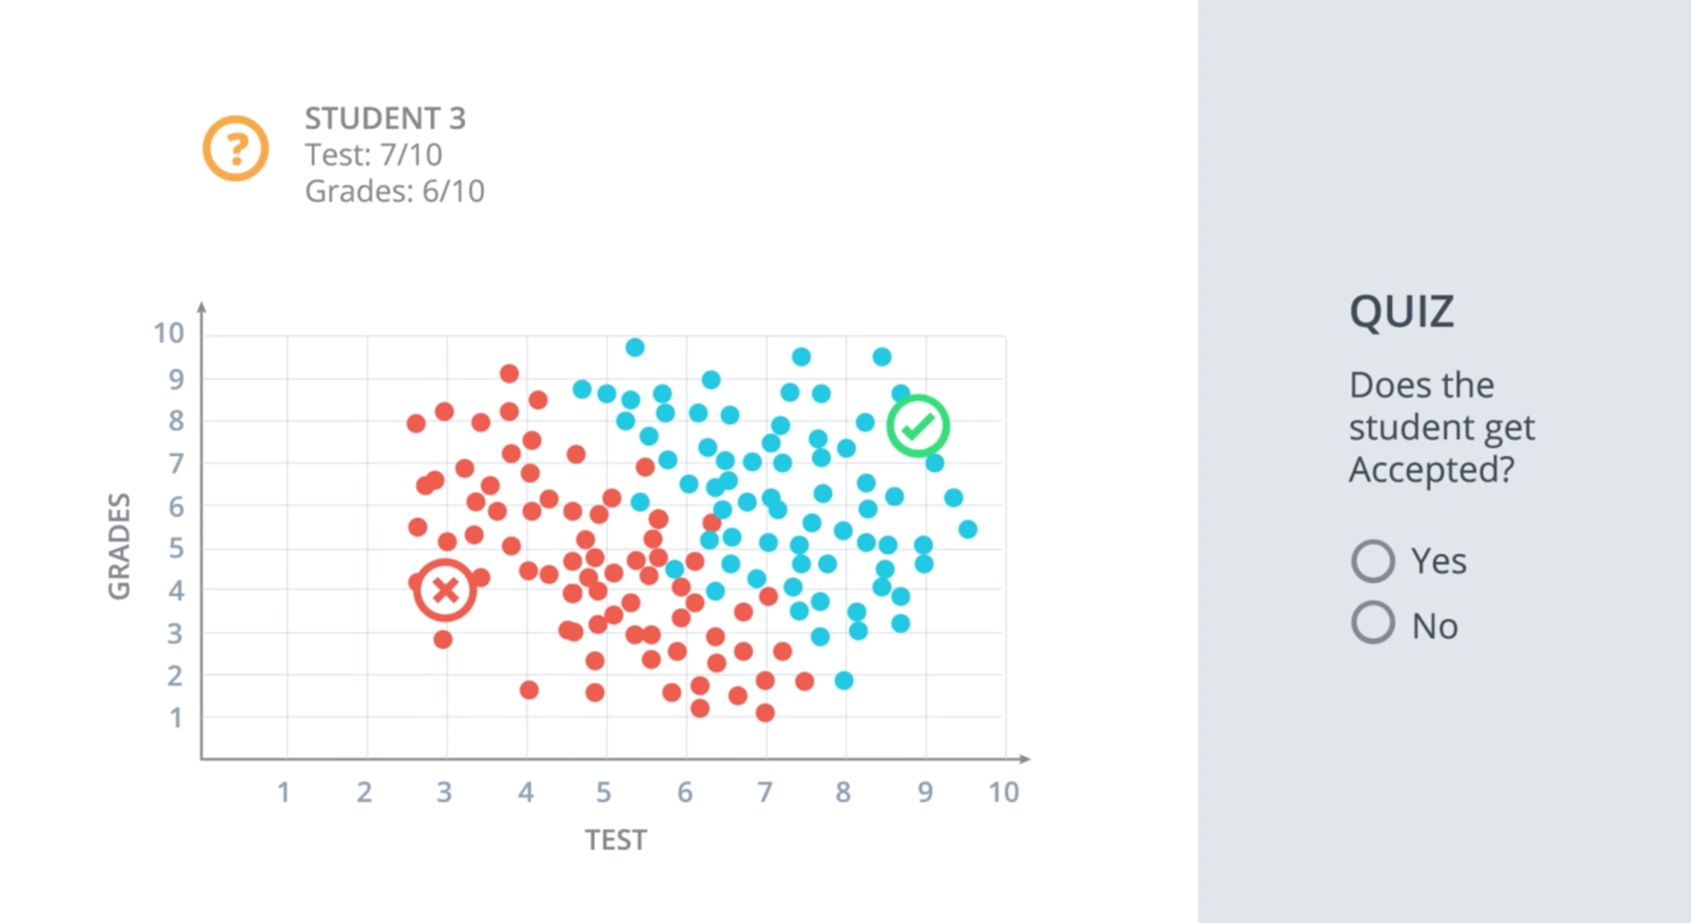
Classification Problem

Slide 10
Linear Boundaries
w1x1+w2x2+b=0
WX+b=0
W=[w1,w2]
X=[x1,x2]
Y = label 0 or 1
If WX+b>= 0 |y=1
If WX+b<0 |y=0

Slide 11
Higher Dimensions
If we have more columns more than one
W1x1+w2x2+w3x3 +b =0
WX +b = 0
W=[w1,w2,w3]
X=[x1,x2,x3]
Y= 1| WX+b>=0
Y=0 | WX+b<0
There can be ‘n’ such dimentions

Slide 12
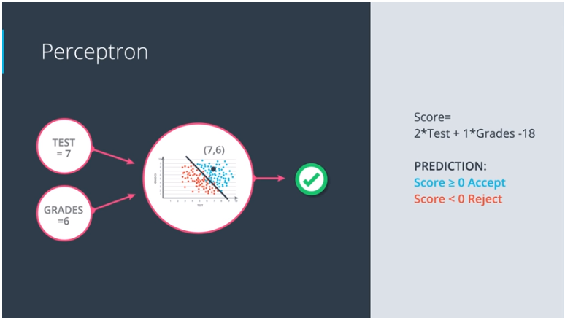
Perceptrons
Basic building block of NN

Slide 13
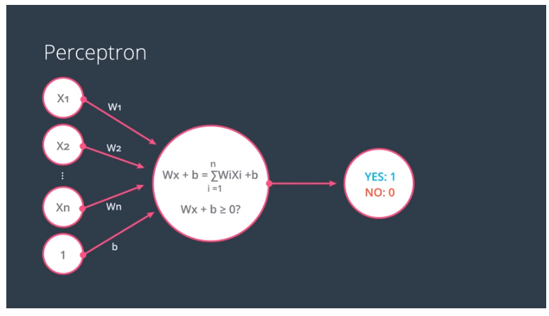
Perceptron

Slide 14
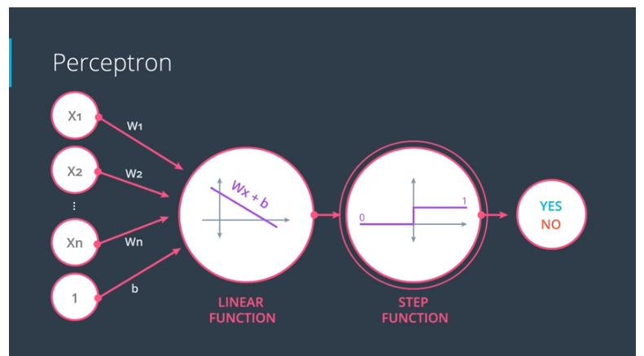
Perceptron

Slide 15
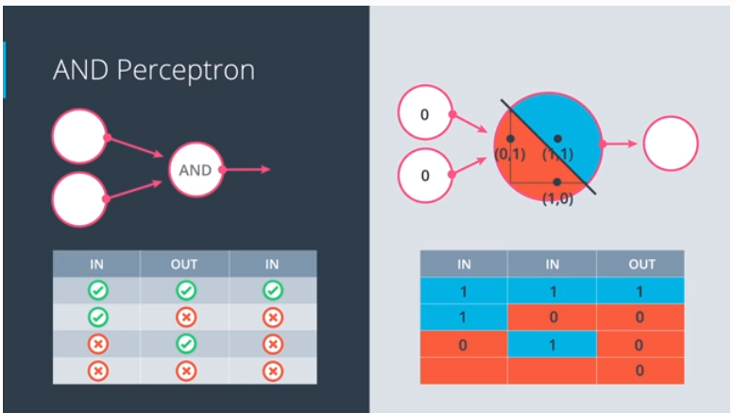
Perceptron

Slide 16
Why neural networks
To generate perceptrons :
In real life, though, we can't be building these perceptrons ourselves. The idea is that we give them the result, and they build themselves. For this, here's a pretty neat trick that will help us.
Draw a random line on the points and see how badly it is doing.
Then move it a little and check again

Slide 17
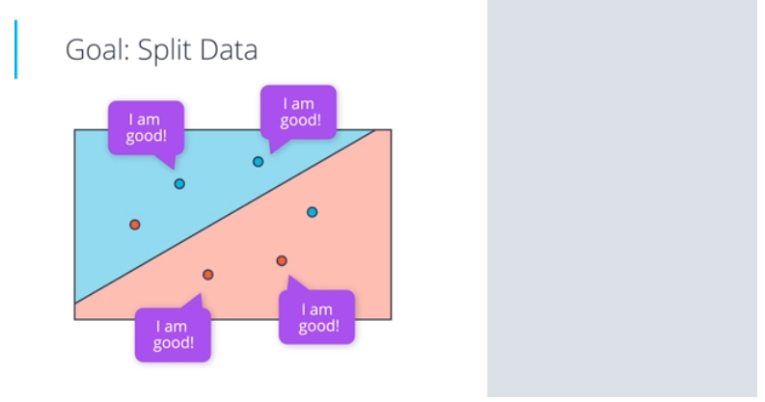
Perceptron Algorithm

Slide 18
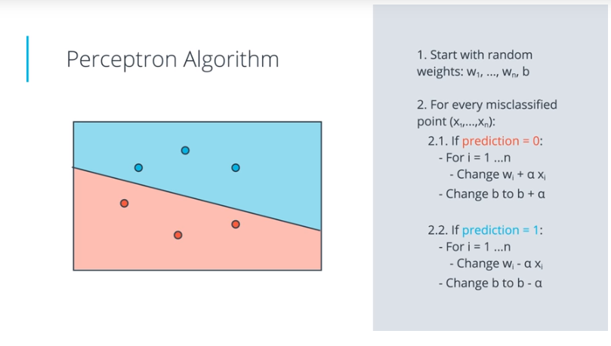
Perceptron Algorithm

Slide 19
Non Linear regions
If we require more complex models than lines
Such as circles , two lines or curves
Then perceptron algorithm won’t help us.

Slide 20
Error function
How far we are from the solution
Log loss error
Gradient descent
Error function can not be discrete
Error function must be differentiable

Slide 21
Log loss error function

Slide 22
Discrete vs Continuous Results
Prediction is the value we get from algorithm
Can have to type Discrete (Yes or no) or Continues values (values between 0 and 1 0.65)
Activation function turns perceptron result to prediction
We have used setp function for predictions so far (if WX+b>=0 then y=1)
Now to make the prediction continues we need to use the sigmoid function instead of step function

Slide 23
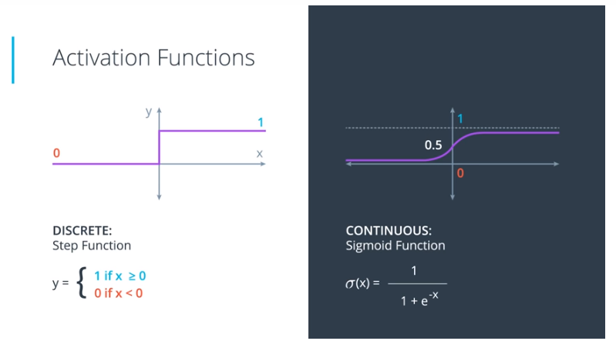
Activation functions

Slide 24
Using Activation function
We can simply combine the perceptron function with activation function
x = WX+b and
sigmoid(x) = 1/(1+e^{-x})

Slide 25
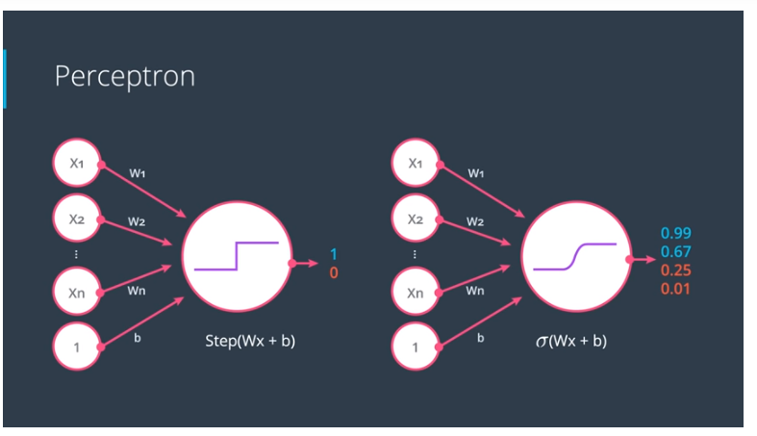
Using Activation function

Slide 26
Softmax function
It is equivelent to sigmoid activation function but when the problem has 3 or more classes
Sigmoid works when have only 2 classes

Slide 27
Softmax function
Classification problem require all the inputs must be probabilities, that means all the inputs be add to 1
We can divide every value with the some of all the values, to satisfy above condition
But what will happen if some of the inputs are negative values.
Exp function can turn all the values into positive values.
So we can apply exp function on every value before summing them and dividing with reach value as described above.
This function is called the softmax function

Slide 28
Softmax function
Classification problem require all the inputs must be probabilities, that means all the inputs be add to 1
We can divide every value with the some of all the values, to satisfy above condition
But what will happen if some of the inputs are negative values.
Exp function can turn all the values into positive values.
So we can apply exp function on every value before summing them and dividing with reach value as described above.
This function is called the softmax function

Slide 29
One-Hot Encoding
If we have multiple classes (more than 2)
Then instead of using different values to represent different classes we will use different columns for different classes that is called One-Hot encoding
It saves us from a lot of complex dependencies

Slide 30
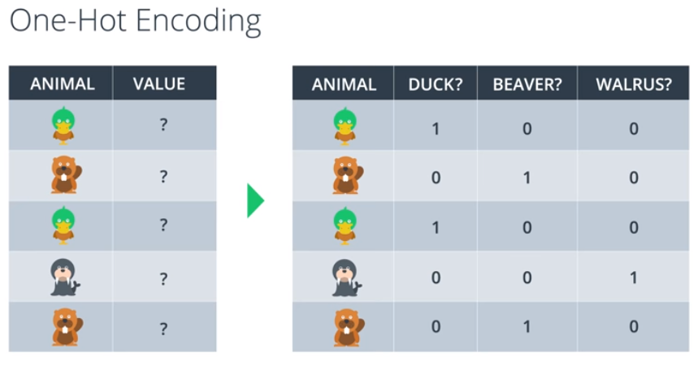
One-Hot Encoding

Slide 31
Maximizing Likelihood
If there are two models we need to choose from
We will pick the model which gives higher probabilities to the event that actually happened
This is called maximum likelihood
We can calculate maximum likelihood by multiplying all the probabilities resulted by the model.
But if there are thousands of number points which are between 0 to 1, then product may be scary
But we can use logs to convert this multiplication into sum

Slide 32
Maximizing Probabilities

Slide 33
Cross Entropy
It is a connection between the error function and the probabilities
In technical terms it is negative sum of the logarithms of the probabilities
Efficient models will have low cross entropy and inefficient models will have high cross entropy
Our goal is to minimize the cross entropy

Slide 34
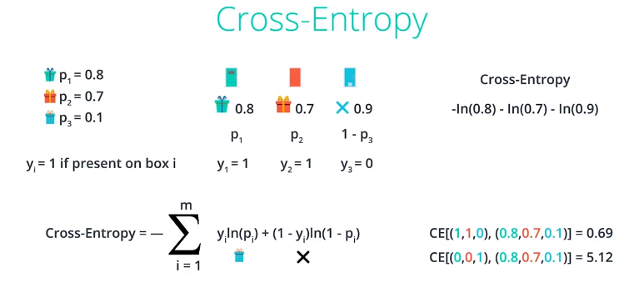
Cross Entropy

Slide 35
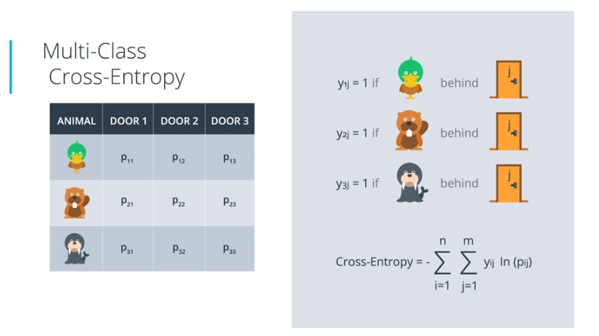
Multiclass Cross Entropy

Slide 36
Logistic Regression
Take your data
Pick a random model
Calculate the error
Minimize the error, and obtain a better model
Enjoy!

Slide 37
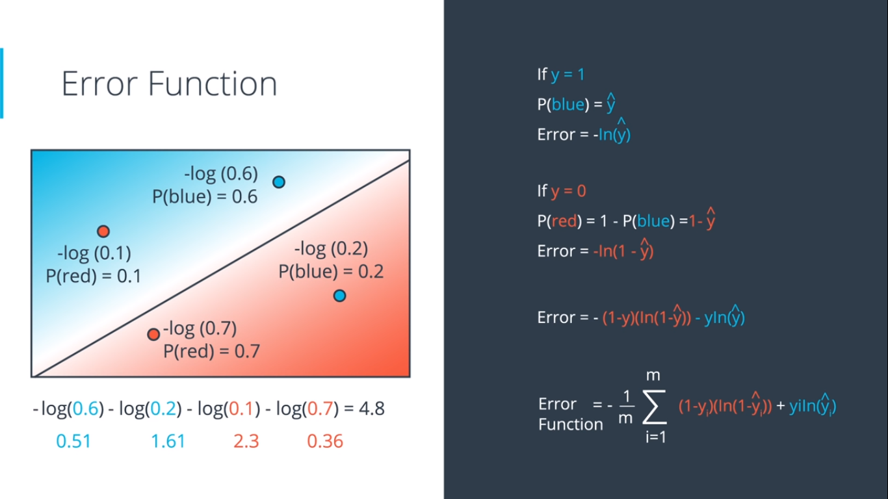
Error function

Slide 38
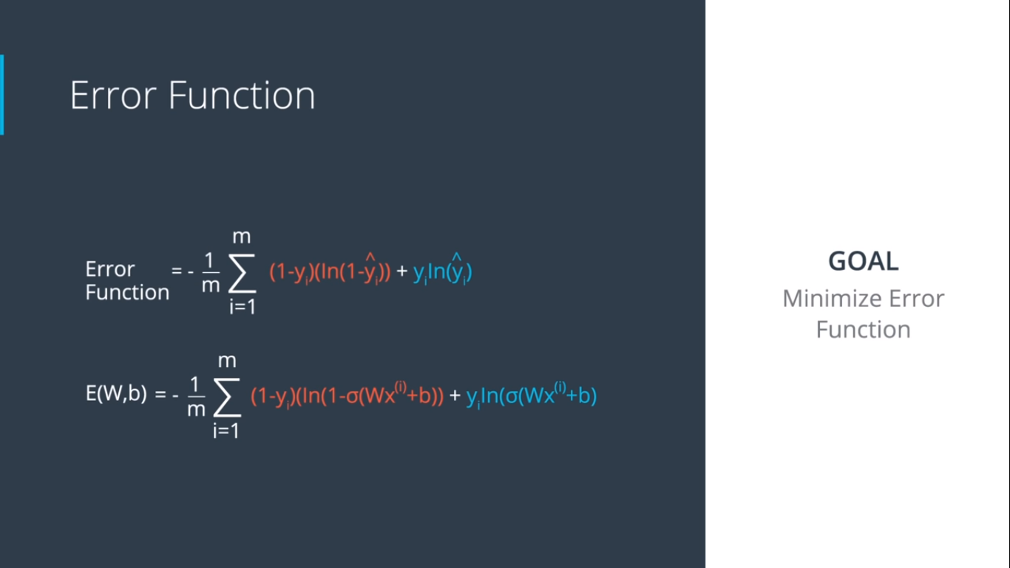
Error function

Slide 39
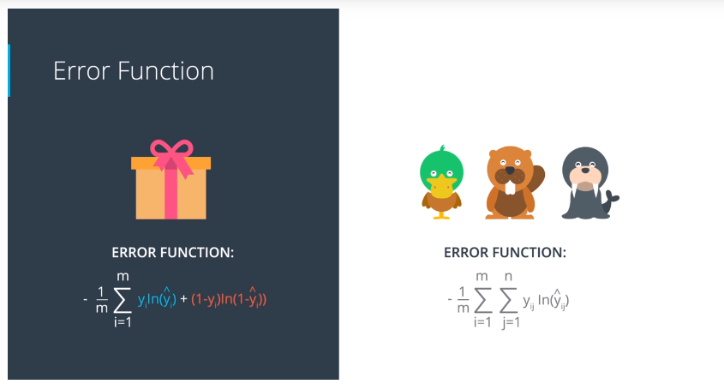
Multiclass error function

Slide 40
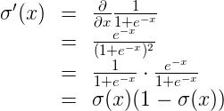
Gradient Descent
Gradient calculation:
σ′(x)=σ(x)(1−σ(x))
The reason for this is the following, we can calculate it using the quotient formula:

Slide 41
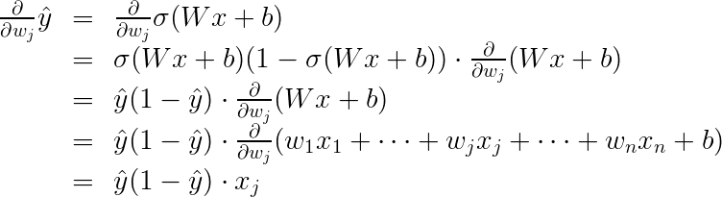
Gradient Descent
For multiclass we have :

Slide 42
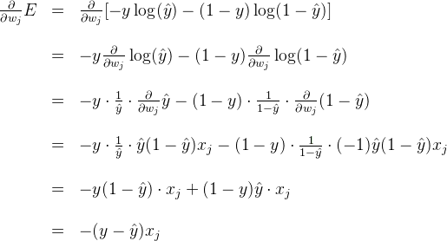
Gradient Descent
Now, we can go ahead and calculate the derivative of the error EE at a point x,x, with respect to the weight wj​ :

Slide 43

Gradient Descent
Gradient of Error function :
Closer the label to the prediction, smaller the gradient.
Farther the label from the prediction, larger the gradient

Slide 44
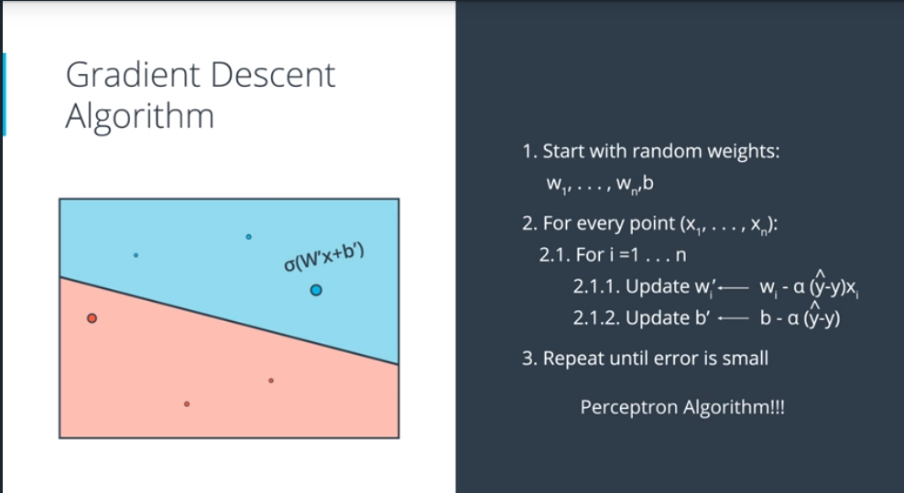
Logistic regression Algorithm

Slide 45
Neural Network Architecture
We can combine two models (Or perseptron) by adding them
Then we have to apply sigmoid funtion to the result to keep the result between 0 and 1
We can also assign weights to each model to control their impact on the result , we can also add a bias if we want
7*model1 + 5*model2 –b
We can implement it using the perceptrons

Slide 46
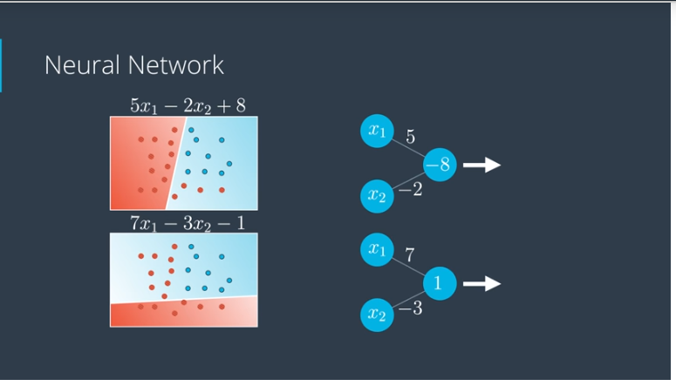
Neural Network Architecture

Slide 47
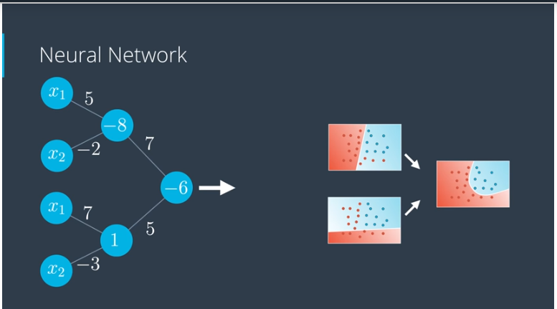
Neural Network Architecture
We join the first two models with a third model (perceptron ) as following

Slide 48
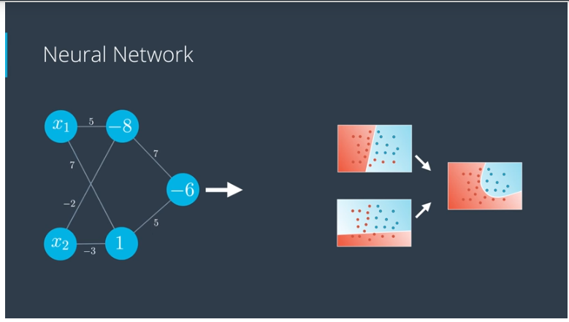
Neural Network Architecture
After little reorganization we can represent it like following

Slide 49
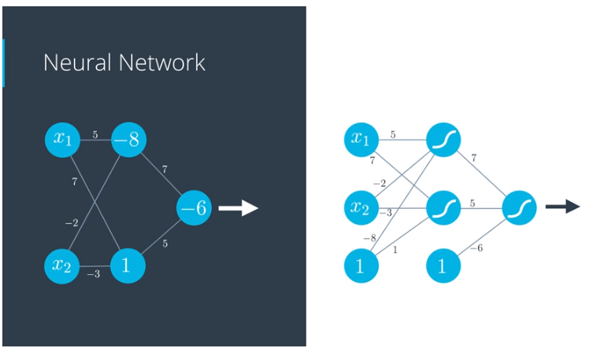
Neural Network Architecture
Applying the sigmoid functions on the results and adding bias as a separate node. We get following diagram.

Slide 50
Neural Network Architecture
As defined so far the neural network has three types of layers
The first layer is input layer
Middle layers are called hidden layers
And the layer which gives us the prediction is called the outputlayer

Slide 51
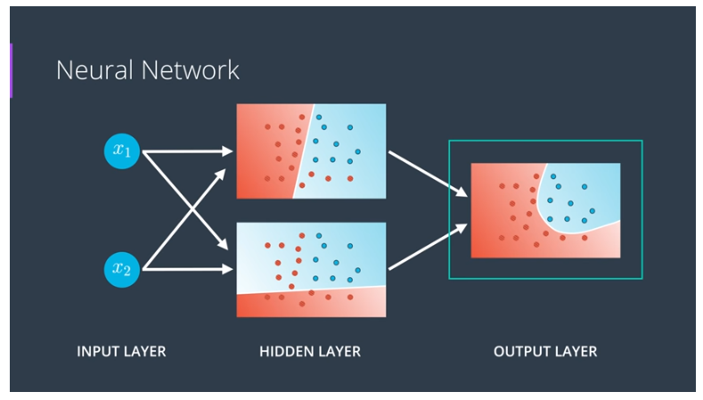
Neural Network Architecture

Slide 52
Multi dimensional NN

Slide 53
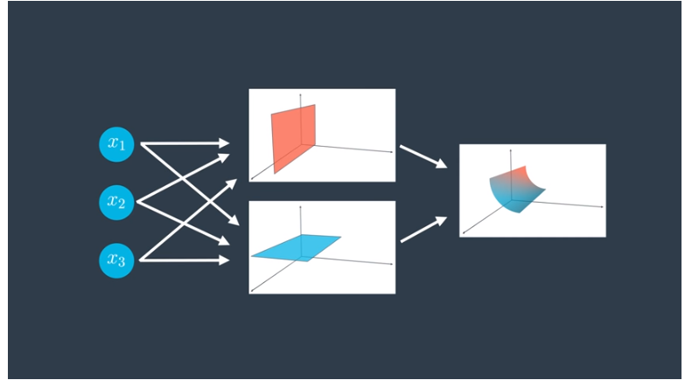
Multi dimensional NN

Slide 54
Single class or predictive models

Slide 55
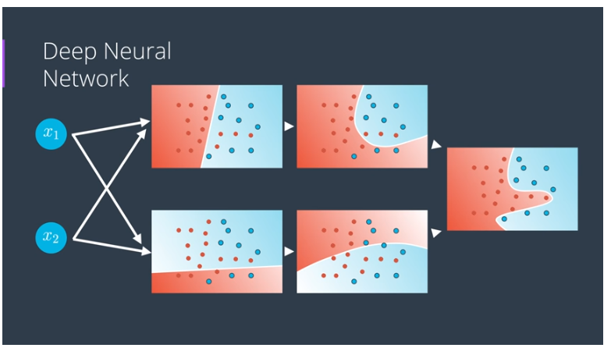
Deep neural networks
If there are more hidden layers then it will be called a deep neural network

Slide 56
Deep neural networks
Here things get exciting .
Many of the real life applications such as self driving cars and game playing agents has many many hidden layers

Slide 57
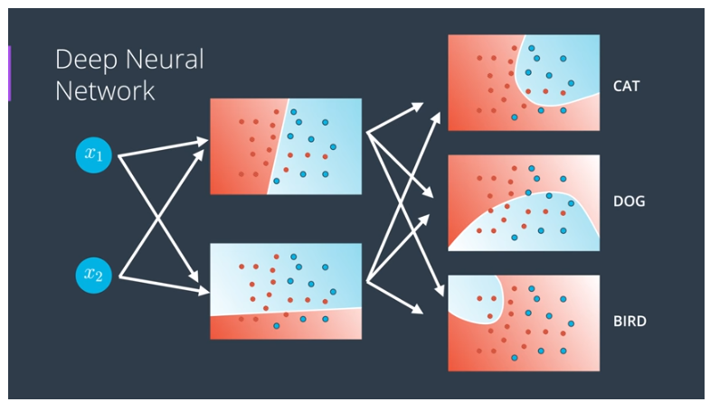
Multi class classification model

Slide 58
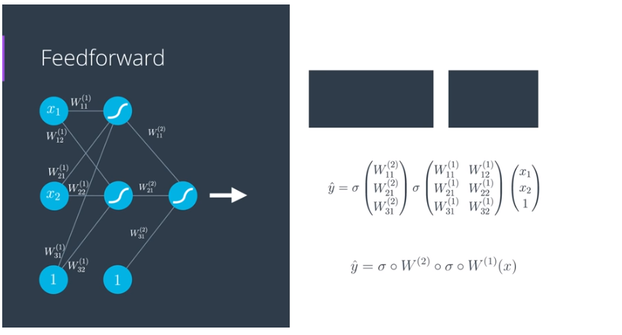
Feedforward
Feedforward is the process neural networks use to turn the input into an output.

Slide 59
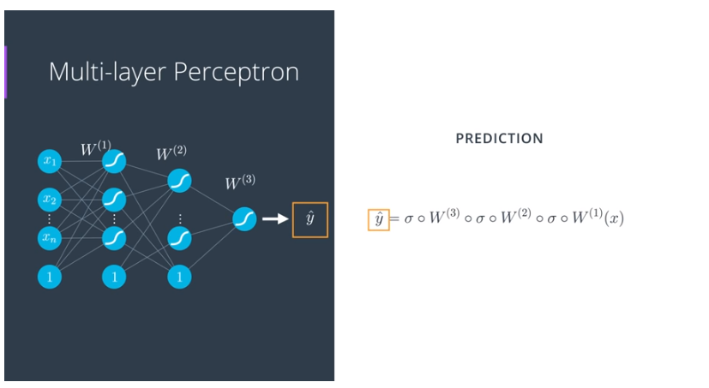
Feedforward

Slide 60
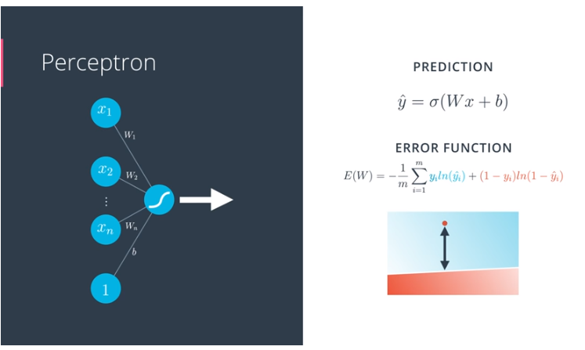
Error function
Just as before, neural networks will produce an error function, which at the end, is what we'll be minimizing.

Slide 61
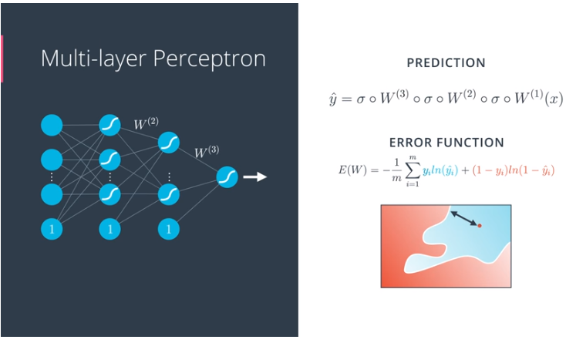
Error function in multilayer NN

Slide 62
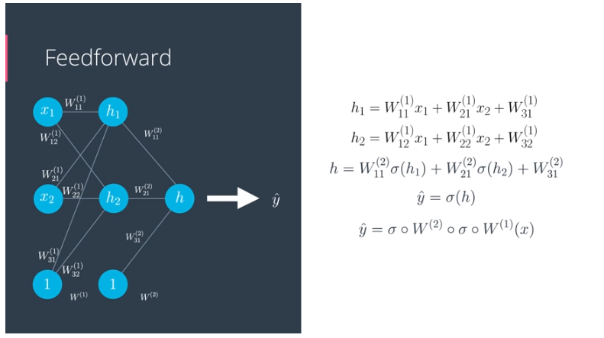
Backpropagation

Slide 63
Backpropagation
Back propagation is just reverse of the feedforward
Basic concept is to spread the error in to all the models in order to correct them
And subsequently get a better model

Slide 64
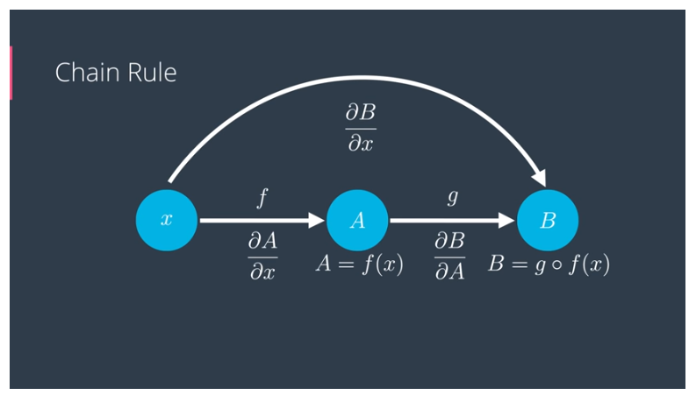
Math behind Backpropagation

Slide 65
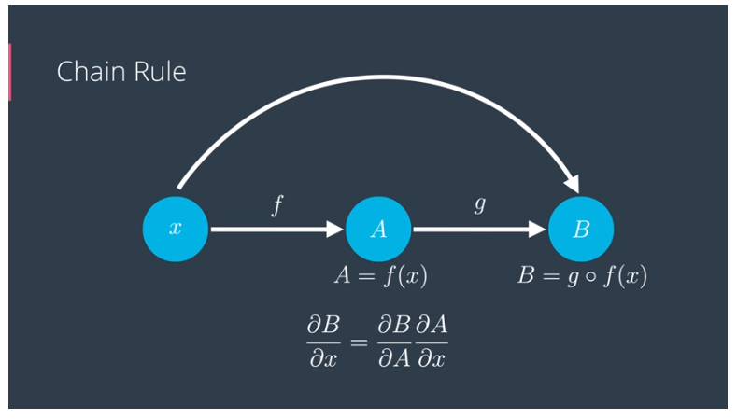
Math behind Backpropagation

Slide 66
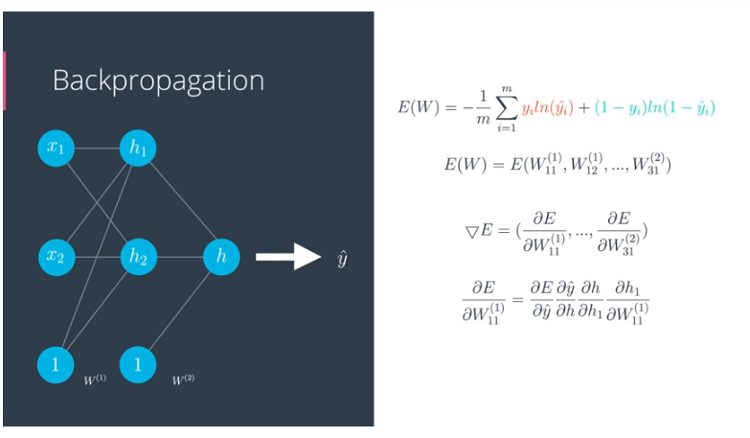
Derivative of the error function

Slide 67
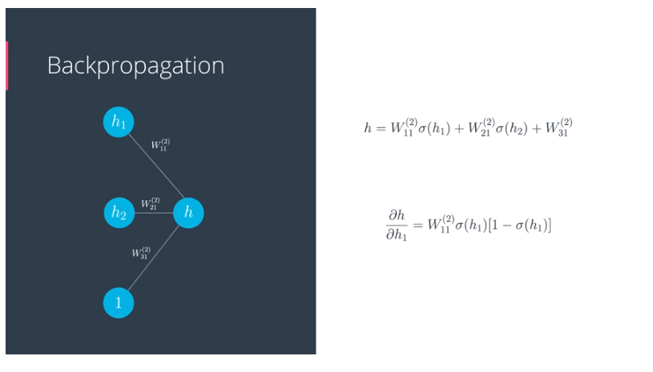
Derivative of the error function

Slide 68
Derivative of sigmoid function

